Slide 1
COSC 290 (Lab) #7
Amaizu Gabriel
gamaizu1@students.towson.edu

Slide 2
Error-checking method
Data transmission
Do you want to save your data?
Yes(1) / No(0)
S: 1 → R: 0
S: 1 → R: 1
Types of Error-checking
Detection
Checking whether the received data bits has an error
Parity check
Correction
Checking which data bit is erroneous + correction!
Hamming code

Slide 3
Parity-checking method
Idea
Count the number of 1s and adjust it to odd or even by a parity bit
Types for parity-checking
Method
Odd
Make the number of 1s odd with a parity bit (Odd: correct, Even: incorrect)
Even
Make the number of 1s even with a parity bit (Even: correct, Odd: incorrect)
Data bits | Parity bit
 | odd | even
1001011 | 1 | 0
0101010 | 0 | 1
0010101 | 0 | 1

Slide 4
Parity-checking method (cont)
Sender
Receiver
Full functions
Parity Generator
Generate a parity bit corresponding to the chosen method, even or odd.
Parity Checker
Result: 1 → no error, 0 → error
Data bits
Parity Generator
Data bits + 1-bit parity
Parity
Checker
Request the message again.

Slide 5
Parity-checking method (cont)
Example of even parity checking method
S: 11011 → R: 11011 (Done)
S: 11011 → R: 11001 (Resend)
S: 11011 → R: 10111 (Done)
Note
Parity checking method is used to detect 1-bit binary error.
It could not find errors with 2n bits (n=1, 2, 3,…).

Slide 6
Parity Generator
Truth table
1st bit | 2nd bit | EVEN parity bit | ODD parity bit
0 | 0 | 0 | 1
0 | 1 | 1 | 0
1 | 0 | 1 | 0
1 | 1 | 0 | 1

Slide 7
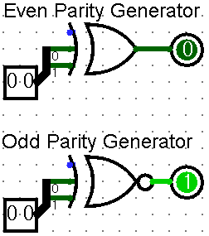
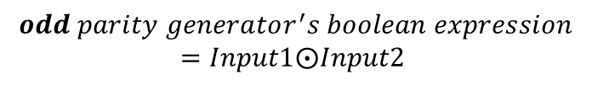
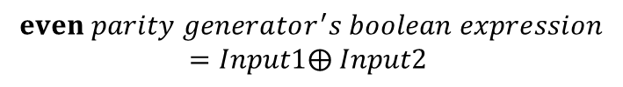
Parity Generator (cont)
Boolean expressions
INPUT1 | INPUT2 | XOR’s OUTPUT | XNOR’s OUTPUT
0 | 0 | 0 | 1
0 | 1 | 1 | 0
1 | 0 | 1 | 0
1 | 1 | 0 | 1
00 (data bits) + 1 (odd parity bit)
01 (data bits) + 1 (even parity bit)
$$even parity generator^{′}s boolean expression$$
$$=Input1⨁ Input2$$
$$odd parity generator^{′}s boolean expression$$
$$=Input1⨀Input2$$

Slide 8
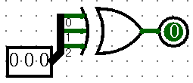
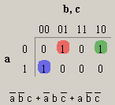
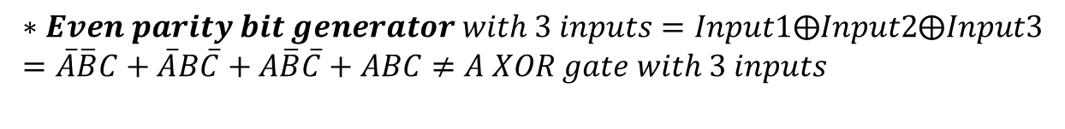
Faults on Parity Generator
A XOR gate w/ 3 inputs
$$∗Even parity bit generator with 3 inputs=Input1⨁Input2⨁Input3 \\ =\overline{A}\overline{B}C+\overline{A}B\overline{C}+A\overline{B}\overline{C}+ABC≠A XOR gate with 3 inputs$$

Slide 9
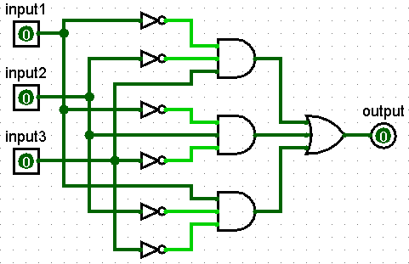

XOR Investigation (cont)
3-input XOR (built in Logisim)

Slide 10
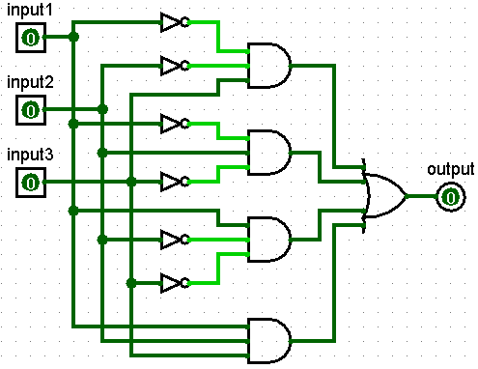
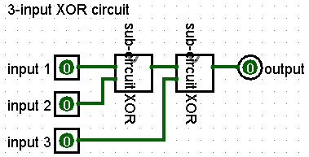
XOR Investigation (cont)
3-input XOR (a chain of 2-input XORs)

Slide 11
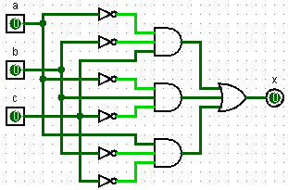
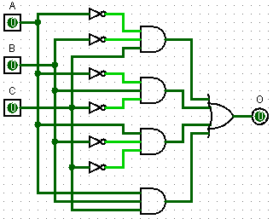
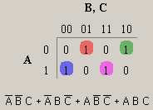
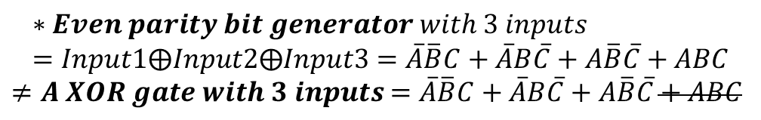
Faults on Parity Generator (cont)
A XOR gate w/ 3 inputs
XOR gates w/ 3 inputs,
a chain of 2-input XORs
$$∗Even parity bit generator with 3 inputs \\ =Input1⨁Input2⨁Input3=\overline{A}\overline{B}C+\overline{A}B\overline{C}+A\overline{B}\overline{C}+ABC$$ $≠A XOR gate with 3 inputs$ $=\overline{A}\overline{B}C+\overline{A}B\overline{C}+A\overline{B}\overline{C}+ABC$

Slide 12

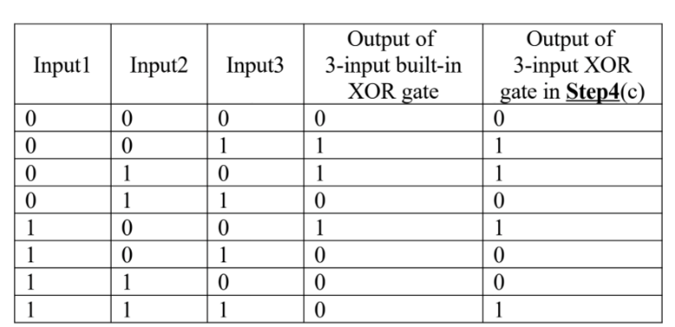
Faults on Parity Generator (cont)

Slide 13
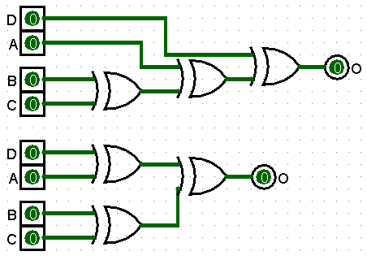
Faults on Parity Generator (cont)

Slide 14
Parity Checker
Caution
1: No error, 0: Error
* logisim

Slide 15
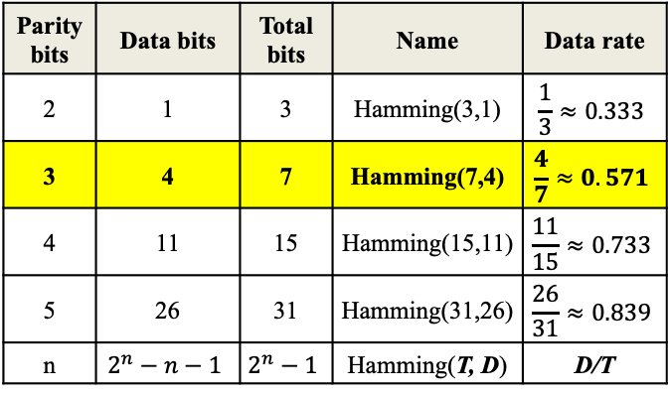

Hamming code 7-4
Invented by Richard Hamming in 1950
Idea
Generate multiple parity bits to make a correction
Format
$Total bits=2^{n}−1 (n:\# of parity bits)$
$Data bits=2^{n}−1−n$
Parity bits | Data bits | Total bits | Name | Data rate
2 | 1 | 3 | Hamming(3,1) | $$\frac{1}{3}≈0.333$$
3 | 4 | 7 | Hamming(7,4) | $$\frac{4}{7}≈0.571$$
4 | 11 | 15 | Hamming(15,11) | $$\frac{11}{15}≈0.733$$
5 | 26 | 31 | Hamming(31,26) | $$\frac{26}{31}≈0.839$$
n | $$2^{n}−n−1$$ | $$2^{n}−1$$ | Hamming(T, D) | D/T

Slide 16
Hamming code (cont)
How to generate Hamming code
1. Choose one of parity-generating methods.
EVEN or ODD

Slide 17
Hamming code (cont)
How to generate Hamming code (cont)
2. Determine the total bits and draw the bit-positioning table.
EVEN
Bit position | 7 | 6 | 5 | 4 | 3 | 2 | 1

Slide 18
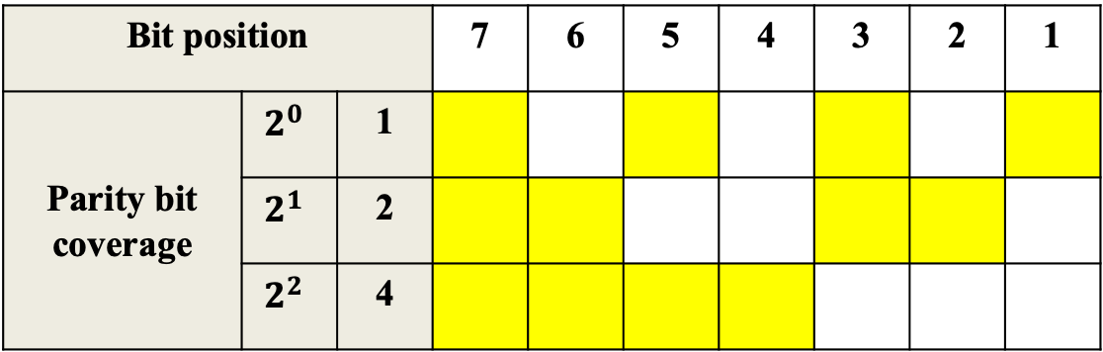
Hamming code (cont)
How to generate Hamming code (cont)
3. Convert each bit-position number into binary.
EVEN
Bit position |  |  | 7 | 6 | 5 | 4 | 3 | 2 | 1
Parity bit coverage | $$2^{0}$$ | 1
 | $$2^{1}$$ | 2
 | $$2^{2}$$ | 4

Slide 19
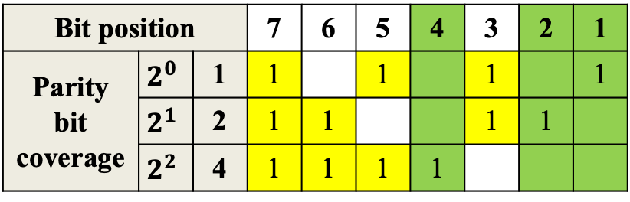
Hamming code (cont)
How to generate Hamming code (cont)
4. Make sure positions for parity bits.
EVEN
Bit position |  |  | 7 | 6 | 5 | 4 | 3 | 2 | 1
Parity bit coverage | $$2^{0}$$ | 1 | 1 |  | 1 |  | 1 |  | 1
 | $$2^{1}$$ | 2 | 1 | 1 |  |  | 1 | 1
 | $$2^{2}$$ | 4 | 1 | 1 | 1 | 1
Parity bit positions: $2^{n}$th $(n=0, 1, 2,…)$

Slide 20
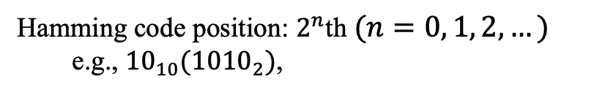
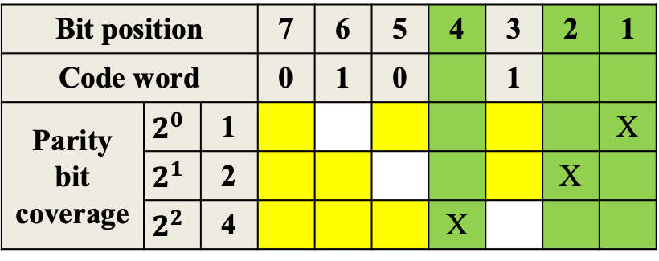
Hamming code (cont)
How to generate Hamming code (cont)
5. Place data bits in the reverse order.
EVEN
Hamming code position: $2^{n}$th $(n=0, 1, 2,…)$
e.g., ${10}_{10}({1010}_{2})$,
Bit position |  |  | 7 | 6 | 5 | 4 | 3 | 2 | 1
Code word |  |  | 0 | 1 | 0 |  | 1
Parity bit coverage | $$2^{0}$$ | 1 |  |  |  |  |  |  | X
 | $$2^{1}$$ | 2 |  |  |  |  |  | X
 | $$2^{2}$$ | 4 |  |  |  | X

Slide 21
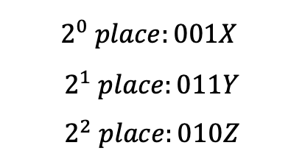
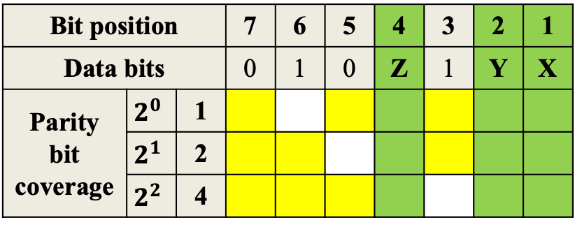
Hamming code (cont)
How to generate Hamming code (cont)
6. Generate each parity bit on each place.
EVEN
Bit position |  |  | 7 | 6 | 5 | 4 | 3 | 2 | 1
Data bits |  |  | 0 | 1 | 0 | Z | 1 | Y | X
Parity bit coverage | $$2^{0}$$ | 1
 | $$2^{1}$$ | 2
 | $$2^{2}$$ | 4
$$2^{0} place:001X$$
$$2^{1} place:011Y \\ 2^{2} place:010Z$$
X, Y, and Z are binary numbers

Slide 22
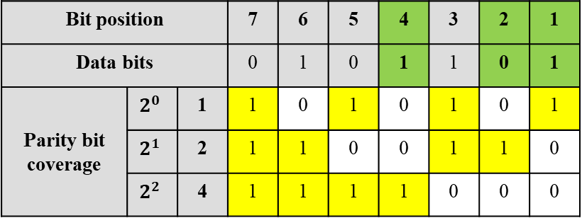
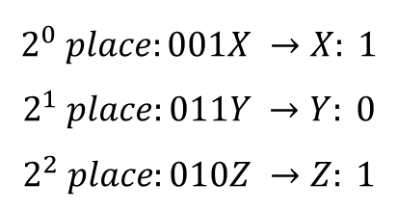
Hamming code (cont)
How to generate Hamming code (cont)
7. Combine the calculated parity bits with data bits.
“EVEN”
Bit position |  |  | 7 | 6 | 5 | 4 | 3 | 2 | 1
Data bits |  |  | 0 | 1 | 0 | 1 | 1 | 0 | 1
Parity bit coverage | $$2^{0}$$ | 1 | 1 | 0 | 1 | 0 | 1 | 0 | 1
 | $$2^{1}$$ | 2 | 1 | 1 | 0 | 0 | 1 | 1 | 0
 | $$2^{2}$$ | 4 | 1 | 1 | 1 | 1 | 0 | 0 | 0
$$2^{0} place:001X →X: 1$$
$$2^{1} place:011Y →Y: 0 \\ 2^{2} place:010Z →Z: 1$$
$$∴Hamming\left(7,4\right):{0101101}_{2}$$

Slide 23

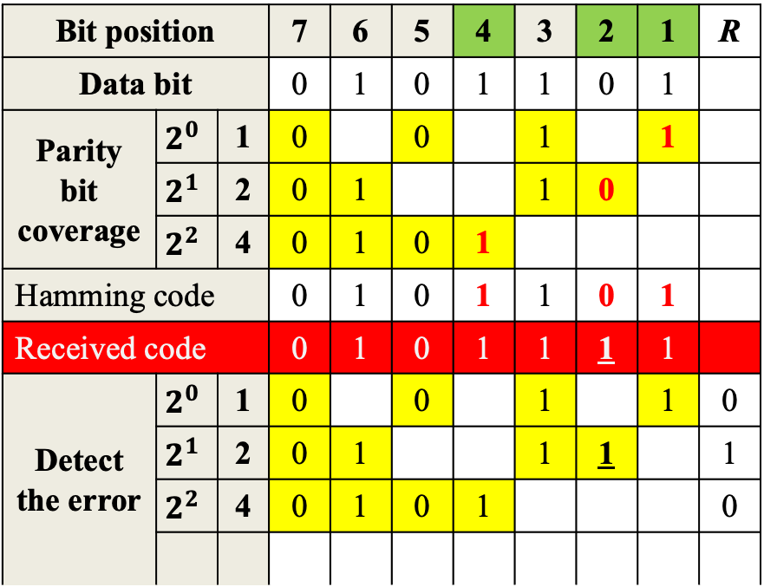
Hamming code (cont)
How to detect an error
Bit position |  |  | 7 | 6 | 5 | 4 | 3 | 2 | 1 | R
Data bit |  |  | 0 | 1 | 0 | 1 | 1 | 0 | 1
Parity bit coverage | $$2^{0}$$ | 1 | 0 |  | 0 |  | 1 |  | 1
 | $$2^{1}$$ | 2 | 0 | 1 |  |  | 1 | 0
 | $$2^{2}$$ | 4 | 0 | 1 | 0 | 1
Hamming code |  |  | 0 | 1 | 0 | 1 | 1 | 0 | 1
Received code |  |  | 0 | 1 | 0 | 1 | 1 | 1 | 1
Detect the error | $$2^{0}$$ | 1 | 0 |  | 0 |  | 1 |  | 1 | 0
 | $$2^{1}$$ | 2 | 0 | 1 |  |  | 1 | 1 |  | 1
 | $$2^{2}$$ | 4 | 0 | 1 | 0 | 1 |  |  |  | 0
[HC-generating process]
1. Choose a parity checking method
2. Determine total bits
3. List up position #s in binary
4. Make sure parity bits’ position
5. Place data bits on the table
6. Generate each parity bit
7. Combine parity bits with data
[HC-checking process]
1. Mimic 1 to 5 of above
2. Calculate parity bit for each place with R
3. Read all Rs in order
4. The number given by R is an error bit-position if it’s not 0 in binary.
$$∴Error {bit}^{′}s position={010}_{2}=2_{10}$$

